Slide 1
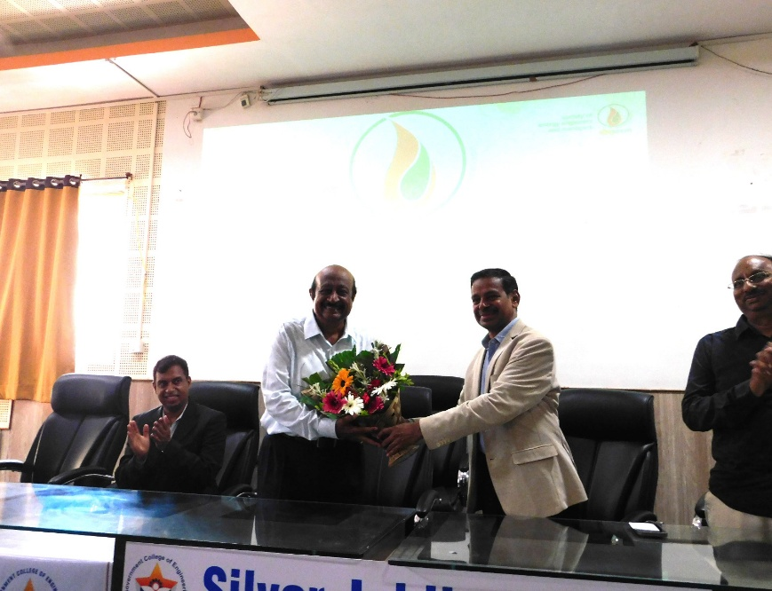
Click here to subscribe to
Click here to become a SEEM member
Previous
Next
Contents
PROGRAM
SEEM Maharashtra & Goa Chapter Organises State Chapter Meet 2026
The Society of Energy Engineers and Managers (SEEM), Maharashtra & Goa Chapter, successfully organised the SEEM Maharashtra & Goa State Chapter Meet 2026 on 25th June 2026 at the Government College of Engineering, Chhatrapati Sambhajinagar. The event was organised in association with the Government College of Engineering with the objective of strengthening collaboration between industry and academia to promote energy efficiency, energy conservation, and sustainable development.
The programme was inaugurated in the gracious presence of Dr. Sanjay Dambhare, Principal, Government College of Engineering, Chhatrapati Sambhajinagar; Dr. Ramakant Shrivastava, Head, Department of Mechanical Engineering; Mr. Punit Hegde, Chairman, SEEM Maharashtra & Goa Chapter; Dr. Mohan Khedkar, President, SEEM; and other distinguished members of SEEM. In his inaugural address, Dr. Dambhare appreciated SEEM's efforts in promoting energy conservation and highlighted the importance of stronger industry–institution collaboration in achieving national sustainability goals.
SEEM NEWS JUNE 2026
A special presentation on SEEM was delivered by Dr. Mohan Khedkar, who highlighted the Society's history, objectives, chapter activities, professional development initiatives, membership growth, and future roadmap. The presentation generated keen interest among faculty members, students, and industrial delegates.
The technical sessions featured insightful presentations by eminent experts from industry and academia. Mr. Ajit Kulkarni of Parason Machinery, Mr. Uttam Zolte, Former Director of MSETCL, and Mr. Kabra, former CGRF member from Urja Sahyog, shared practical perspectives on energy conservation, renewable energy integration, and policy support for sustainable industrial growth.
Further technical presentations were delivered by representatives from Mercury Pneumatics, Dr. Arvind Chel, Dr. (Mrs.) V. A. Kulkarni, and Dr. Nitin Phadkule, who highlighted emerging technologies, innovative products, and the growing role of Artificial Intelligence in energy management and industrial energy efficiency.
Subscription to SEEM NEWS is free for members and non-members

Slide 2
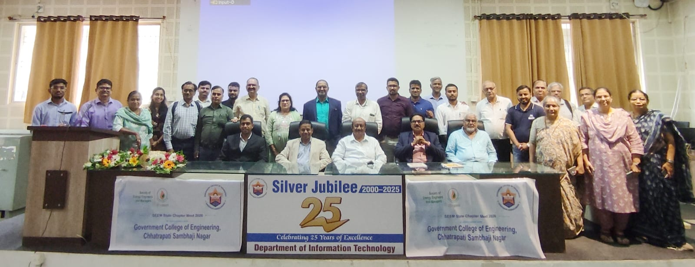
Click here to subscribe to
Click here to become a SEEM member
Previous
Next
Contents
PROGRAM
The post-lunch session showcased successful case studies by experienced SEEM members Mr. Punit Hegde, Mr. P. K. Shreekanth, and Mr. Santosh Mestry, who shared best practices and practical implementation experiences that resulted in measurable energy savings across industrial applications.
A panel discussion on "Strengthening Industry–Academia Collaboration for Sustainable Growth", moderated by Dr. B. V. Suryavanshi, brought together distinguished experts from academia and industry. The discussion focused on skill development, collaborative research, industry internships, technology transfer, consultancy opportunities, and strengthening partnerships between educational institutions and industries. Delegates actively participated and contributed several constructive suggestions.
An interactive Open House session followed, during which participants discussed the future roadmap for the Maharashtra & Goa Chapter. Key topics included establishing Student Chapters, expanding SEEM membership, creating Industry Outreach Centres, promoting SEEM Awards, renewable energy integration, electric vehicles and battery technologies, capacity-building programmes, and knowledge-sharing initiatives. The queries raised were effectively addressed by Dr. Mohan Khedkar, Mr. P. K. Shreekanth, and Mr. Punit Hegde.
SEEM NEWS JUNE 2026
Subscription to SEEM NEWS is free for members and non-members
The meeting concluded with a strong consensus on enhancing industry–academia collaboration, expanding Student Chapters and SEEM membership, organising more technical programmes and industrial visits, encouraging greater industry participation, and strengthening networking among energy professionals.
The event concluded with a heartfelt Vote of Thanks proposed by Mr. Sudhir Budhay, Secretary, SEEM Maharashtra & Goa Chapter, who expressed gratitude to the Government College of Engineering, distinguished dignitaries, speakers, sponsors, faculty members, volunteers, and delegates for their valuable support and contribution towards the success of the programme. The participants later interacted during High Tea, followed by a group photograph commemorating the successful State Chapter Meet.

Slide 3
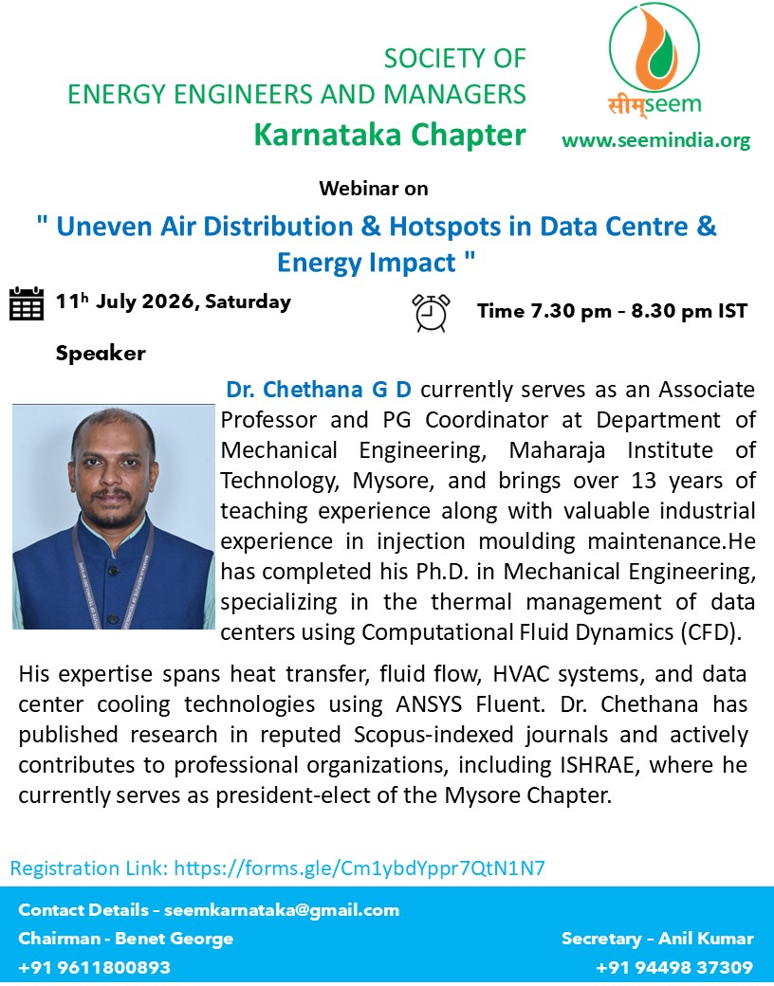
Click here to subscribe to
Click here to become a SEEM member
Previous
Next
Contents
PROGRAM
SEEM Karnataka Chapter Invites You to an Expert Webinar on Data Centre Energy Efficiency
The Society of Energy Engineers and Managers (SEEM) – Karnataka Chapter cordially invites energy professionals, HVAC engineers, facility managers, researchers, students, and industry practitioners to participate in an insightful webinar on:
"Uneven Air Distribution & Hotspots in Data Centre & Energy Impact“
📅 Date: 11th July 2026 (Saturday)
🕢 Time: 7:30 PM – 8:30 PM IST
The session will be delivered by Dr. Chethana G. D., Associate Professor and PG Coordinator, Department of Mechanical Engineering, Maharaja Institute of Technology, Mysore.
Dr. Chethana brings over 13 years of teaching and industrial experience and has specialized expertise in thermal management of data centres using Computational Fluid Dynamics (CFD). His areas of interest include heat transfer, fluid flow, HVAC systems, data centre cooling technologies, and ANSYS Fluent simulations. He is also President-Elect of the ISHRAE Mysore Chapter and has published several research papers in reputed Scopus-indexed journals.
The webinar will provide valuable insights into the causes of uneven airflow and hotspot formation in data centres, their impact on energy consumption and cooling efficiency, and practical approaches to improving thermal performance through optimized airflow management.
SEEM warmly invites all members, professionals, academicians, and students interested in energy management, HVAC, and data centre cooling technologies to attend this informative session.
Registration Link: https://forms.gle/Cm1ybdYppr7QtN1N7
Google Meet joining info
Video call link: https://meet.google.com/isr-azbg-dro
SEEM NEWS JUNE 2026
Subscription to SEEM NEWS is free for members and non-members

Slide 4
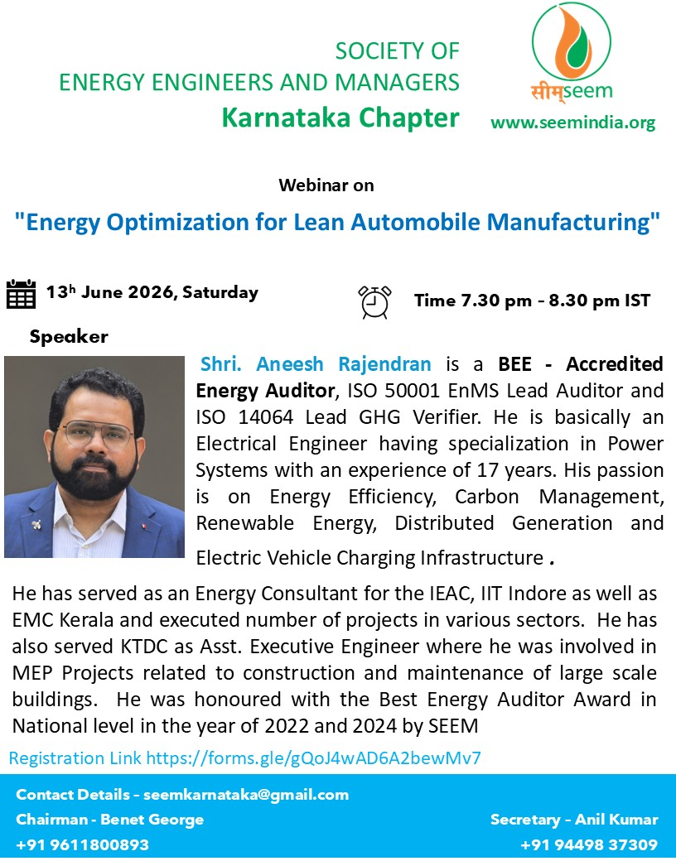
Click here to subscribe to
Click here to become a SEEM member
Previous
Next
Contents
PROGRAM
SEEM Karnataka Chapter Organised Webinar on “Energy Optimization for Lean Automobile Manufacturing”
The Society of Energy Engineers and Managers (SEEM), Karnataka Chapter, successfully organised an online technical webinar on “Energy Optimization for Lean Automobile Manufacturing” on 13th June 2026 from 7.30 p.m. to 8.30 p.m. (IST). The webinar was offered free of cost and was open to energy professionals, engineers, students, and industry members.
The technical session was delivered by Shri Aneesh Rajendran, a BEE Accredited Energy Auditor, ISO 50001 Energy Management Systems (EnMS) Lead Auditor, and ISO 14064 Lead GHG Verifier. An Electrical Engineer with specialization in Power Systems and over 17 years of professional experience, Shri Aneesh is the Founder and CEO of New Sky Energy Solutions, a sustainability consultancy based in Thiruvananthapuram, Kerala.
During the webinar, Shri Aneesh highlighted the importance of integrating energy optimisation strategies with lean manufacturing practices to improve operational efficiency in the automobile industry. He discussed practical approaches for reducing energy consumption, eliminating process waste, enhancing productivity, and achieving sustainable manufacturing through effective energy management. The session also emphasized the role of continuous improvement, performance monitoring, and modern energy management techniques in supporting lean manufacturing objectives.
The webinar witnessed enthusiastic participation from professionals representing various industries, educational institutions, and the energy management fraternity. An interactive question-and-answer session at the end of the presentation enabled participants to clarify technical queries and exchange practical experiences.
The programme concluded with a vote of thanks, appreciating the speaker for sharing his valuable expertise and acknowledging the active participation of all attendees. The webinar reaffirmed SEEM Karnataka Chapter's commitment to promoting knowledge sharing and advancing energy efficiency and sustainable industrial practices through regular technical programmes.
SEEM NEWS JUNE 2026
Subscription to SEEM NEWS is free for members and non-members

Slide 5
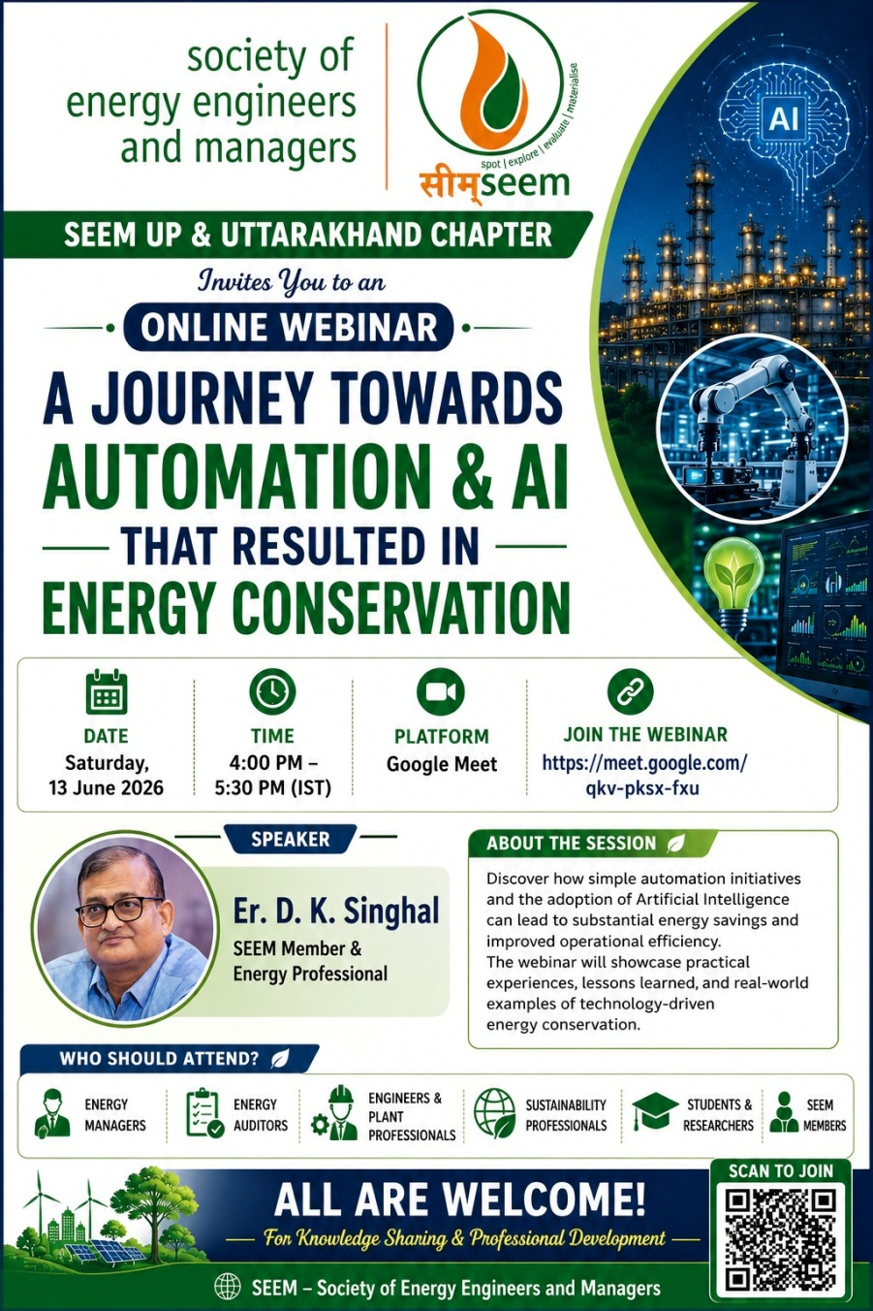
Click here to subscribe to
Click here to become a SEEM member
Previous
Next
Contents
PROGRAM
SEEM UP & Uttarakhand Chapter Organised Webinar on “A Journey towards Automation & AI that Resulted in Energy Conservation”
The Society of Energy Engineers and Managers (SEEM), UP & Uttarakhand Chapter, successfully organised an online webinar on “A Journey towards Automation & AI that Resulted in Energy Conservation” on 13th June 2026 from 4.00 p.m. to 5.30 p.m. (IST).
The technical session was delivered by Er. D. K. Singhal, a distinguished SEEM Member, who shared his practical experiences on implementing automation technologies and Artificial Intelligence (AI) to achieve measurable energy conservation across industrial applications.
During the session, Er. Singhal explained how the adoption of automation and AI-driven solutions has transformed conventional energy management practices by enabling real-time monitoring, intelligent control systems, predictive analysis, and data-driven decision-making. Through practical case studies and examples, he demonstrated how these technologies can improve operational efficiency, optimise energy consumption, reduce wastage, and support sustainable industrial growth.
The webinar also highlighted the growing role of digital technologies in enhancing the performance of energy management systems and emphasized the need for energy professionals to embrace emerging technologies to meet future energy efficiency and sustainability goals.
The programme attracted enthusiastic participation from SEEM members, energy managers, energy auditors, engineers, students, and industry professionals from different parts of the country. The interactive question-and-answer session provided participants with an opportunity to engage directly with the speaker and discuss practical challenges and innovative solutions in automation and AI-based energy management.
The webinar concluded with a vote of thanks, expressing sincere appreciation to Er. D. K. Singhal for delivering an informative and insightful presentation. The event once again reflected SEEM UP & Uttarakhand Chapter's commitment to promoting technical excellence and fostering knowledge sharing in the field of energy efficiency and sustainable development.
SEEM NEWS JUNE 2026
Subscription to SEEM NEWS is free for members and non-members

Slide 6
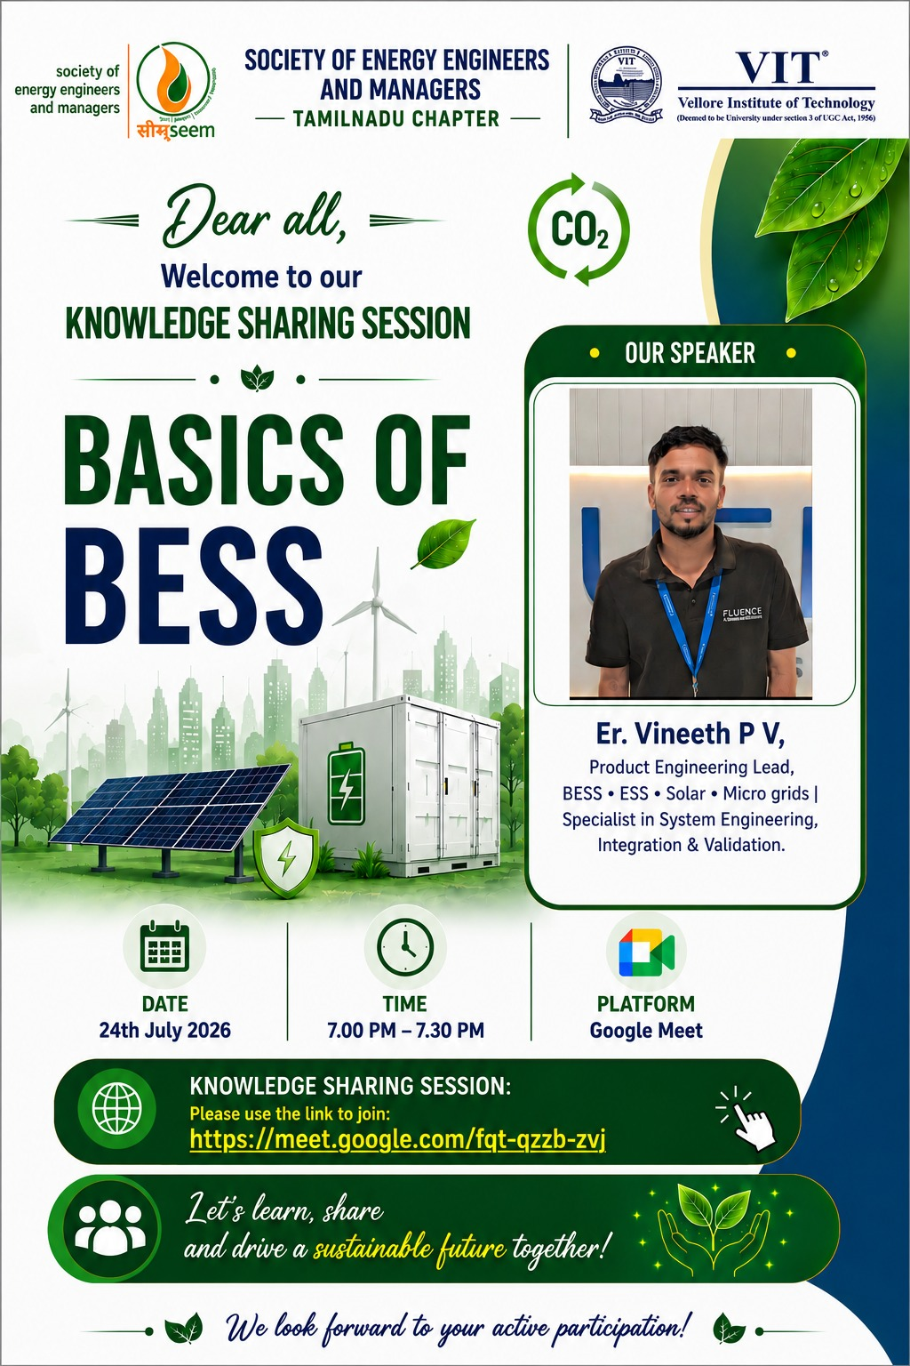
SEEM Tamilnadu chapter knowledge sharing session on “Basics of BESS”

Slide 7
Click here to subscribe to
Click here to become a SEEM member
Previous
Next
Contents
PROGRAM
SEEM Karnataka Chapter Conducts Webinar on “Fast Breeder Reactor Technology Development and PFBR – The Indian Success Story”
The Karnataka Chapter of the Society of Energy Engineers and Managers (SEEM) organized an online technical webinar on “Fast Breeder Reactor Technology Development and PFBR – The Indian Success Story” on 9 May 2026. The webinar was attended by energy professionals, engineers, academicians, students, and SEEM members from across the country.
The expert speaker for the session was Dr. C. V. Srinivasa Rao, Ph.D. (Physics) from IIT Kanpur, who served at the Institute for Plasma Research (IPR), Gandhinagar, Gujarat, from 1982 to 2017 and retired as Group Director. Drawing upon his extensive experience in advanced energy technologies, Dr. Rao delivered an insightful presentation on the development of Fast Breeder Reactor (FBR) technology in India and the successful realization of the Prototype Fast Breeder Reactor (PFBR).
During the webinar, Dr. Rao explained the strategic importance of breeder reactor technology in enhancing fuel utilization and ensuring long-term energy security for the nation. He highlighted the technological advancements, engineering challenges, and innovative indigenous solutions that contributed to the successful development of the PFBR, widely regarded as a significant milestone in India’s nuclear energy programme.
The presentation also covered the three-stage nuclear power programme of India, the role of fast breeder reactors in sustainable energy development, and the future prospects of advanced nuclear technologies in meeting the country’s growing energy demand. Participants gained valuable insights into the scientific, technological, and operational aspects of breeder reactor systems.
The session concluded with an engaging question-and-answer segment, during which participants interacted actively with the speaker and sought clarifications on various technical aspects related to reactor technology, safety, and future developments in the nuclear sector.
The webinar was highly appreciated by the participants for its technical depth and relevance. Through such knowledge-sharing initiatives, SEEM Karnataka Chapter continues to promote professional excellence and dissemination of advanced energy technologies among the engineering community.
SEEM NEWS JUNE 2026
Subscription to SEEM NEWS is free for members and non-members

Slide 8

Click here to subscribe to
Click here to become a SEEM member
Previous
Next
Contents
PROGRAM
SEEM Tamil Nadu Chapter Conducts Knowledge Sharing Session on Carbon Credit Trading Schemes
The Tamil Nadu Chapter of the Society of Energy Engineers and Managers (SEEM), in association with Vellore Institute of Technology (VIT), organized an online Knowledge Sharing Session on “Carbon Credit Trading Schemes – CCTS Mechanism to be Understood” on 5 June 2026. The session was delivered by Mr. Nand Gopal Esambadi, Director – Climate and Energy Practice, Grant Thornton Bharat LLP, who shared his expertise on the evolving carbon market landscape and the implementation of Carbon Credit Trading Schemes (CCTS) in India. Welcoming the participants, the organizers highlighted the growing importance of market-based mechanisms in achieving national and global climate goals. The webinar attracted energy professionals, sustainability practitioners, faculty members, students, and industry representatives interested in understanding the emerging carbon trading framework.
During his presentation, Mr. Esambadi provided a comprehensive overview of carbon credit trading mechanisms, explaining their role in incentivizing greenhouse gas emission reductions and supporting the transition to a low-carbon economy. He elaborated on the objectives, structure, and implementation framework of the Carbon Credit Trading Scheme (CCTS) and discussed its relevance to Indian industries in the context of national climate commitments.
The speaker also addressed key aspects such as carbon accounting, compliance requirements, opportunities for industries to participate in carbon markets, and the potential benefits of adopting sustainable practices. Participants gained valuable insights into the regulatory developments, challenges, and future prospects of carbon trading in India. The session featured active interaction from participants, who raised several questions related to carbon credits, emissions reporting, market mechanisms, and organizational preparedness for the emerging regulatory framework. Mr. Esambadi responded with practical examples and industry perspectives, making the session highly informative and engaging.
SEEM NEWS JUNE 2026
Subscription to SEEM NEWS is free for members and non-members
The programme concluded with a vote of thanks to the speaker and participants. Attendees appreciated the session for providing clarity on a complex and rapidly evolving subject that is expected to play a significant role in India's decarbonization journey. Through such knowledge-sharing initiatives, SEEM Tamil Nadu Chapter continues to enhance awareness and build professional capacity in the areas of energy management, sustainability, climate action, and environmental stewardship.

